Slide 1
Support Forum
Trusted AI “TAI” Support Enablement

Slide 2
Timeline:
15th November: “TAI” go-live on IE1-Quartz & US5-Diamond
Expected 22nd November: “TAI” go-live on US3-Opal
Expected 31st December: “TAI” go-live on all platforms except:
China, Saudi Arabia, Canada and UAE
2026 Q1 next year: 1x PC21-0001 Kyriba Units - 500 & PC22-0002 TAI Agents embedded
into cash management renewals. (Expected mid-January)

Slide 3
How to explain what TAI is to customers
TAI is an agentic AI because it will plan and execute governed, multi‑step treasury workflows on trusted Kyriba data—with explainability, role‑based controls, and full auditability—rather than merely a AI chatbot responding to prompts.
For a full explanation of “Trusted AI portfolio”, “TAI” etc, please review the Kyriba website:
https://www.kyriba.com/use-cases/kyriba-trusted-ai/

Slide 4
What is “TAI”?
An agent interprets the user’s request and then engages in a chain of thought, a reasoning process where it breaks down the problem into steps.
Based on this reasoning, the agent identifies which tools or data sources might help, calls them, observes the results, and adapts its plan if needed. This loop continues until the agent can provide a complete, reliable answer to the user.
“TAI” is Kyriba’s agentic AI.
Currently there are two “agents” within ‘TAI agents’:
Treasury agent:
Producing reporting/analysis
Reduce customer time investigating breaks
Help agent:
Asking questions on how to use Kyriba from Kyriba’s Online Help.
Supports new user at implementation, as well as during day-to-day maintenance operations, reducing the number of user questions to Kyriba experts and support.
The scope on how TAI can be used is endless. Examples are available at these resources:
Example queries: Factsheet: TAI Capabilities
Pre sales demos:
Meet TAI: The Next Leap in AI-Powered Treasury
2025 - Module Intro - TAI 2 (EN)

Slide 5

How to use TAI
Adam Bridgewater
A.I. Innovation Manager

Slide 6
INTERFACE DEMO
Contents:
UI navigation
Charting
Conversations & limitations on conversations with soft-limit warning at 60k
Guardrails, history, context & clearing conversations
Copy/paste, feedback, replay.
Reasoning
Help agent
Clearing cache trick
Notes:
Is currency MXN set up? Are there any companies set up with this currency? What continent is MXN on?

Slide 7
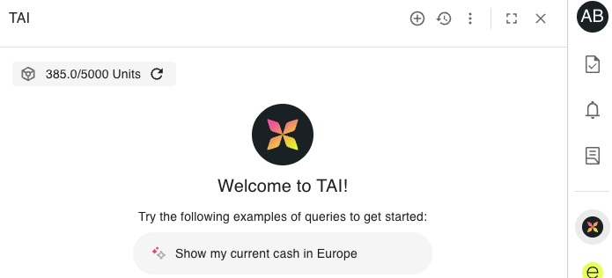
How units work
Customers purchasing PC01-0022 TAI Agents at zero cost will get access to the TAI interface.
Customers will need to also purchase PC01-0021 Kyriba Units - 500 to have ‘Kyriba units’ to use in TAI.
If a customer runs out of Kyriba units, then they need to purchase more units, or wait until the next month for the unit usage counter to reset.
500 units is roughly equivalent to 100 queries a month, which is roughly expected to be the average usage of 1x user.
Cost per query varies as different questions/answers will result in more/fewer reasoning steps on more/less data as well as resulting in longer/shorter answers
The number of units a customer can have access to is the quantity of PC01-0021 x 500 and displayed as below
The units are pooled across all of the customer’s users and reset on the 1st of every month.
The unit tracker can take 20 mins to 1 hour to update.
In the near future, Kyriba Units may be used for other Kyriba services.
Use of TAI by
CONSULTANT01 & CONSULTANT02 will decrease the number of Kyriba units available to the customer.
SUPPORT01 & SUPPORT02 & HOTLINE is monitored but does not decrease the number of Kyriba units available to the customer.
500 units a month has been added to each production CMP11 environment which is available now.

Slide 8
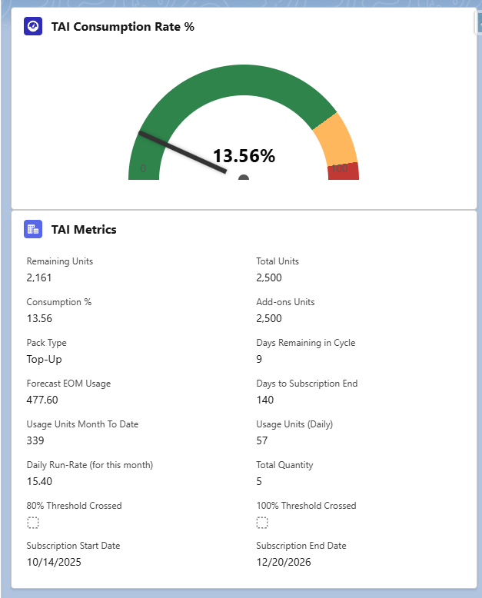
How to Monitor TAI Usage in SFDC (Account)
TAI consumption rate by month
Total Number of Units Purchased
Total Number of Units Remaining
Add-on Units Purchased (Packs)
Days Left in the Month
Given Unit Consumption, How Many Units Will Be Used
Days Left for Subscription
Units Usage In Month So Far
Daily Usage Average
This is in Salesforce for Support/Account management, but long term is likely also be presented to customers in Salesforce.

Slide 9

How to troubleshoot
João Pedro Almeida
Manager, Northern Europe and Germany - Client Support EMEA

Slide 10




Key people
Support: TAI subject matter experts:
Illia Duverkher-Natiahin Brian Ouellette Todd Hanni
EMEA-Senior Technical Support Engineer NORAM-Support Consultant Technical Support Engineer
(Technical errors are not expected and
Product: Likely responding to escalations: likely should be resolved by dev team)
Adam Bridgewater Anton Budkevich
A.I. Innovation Manager TAI Product Owner

Slide 11
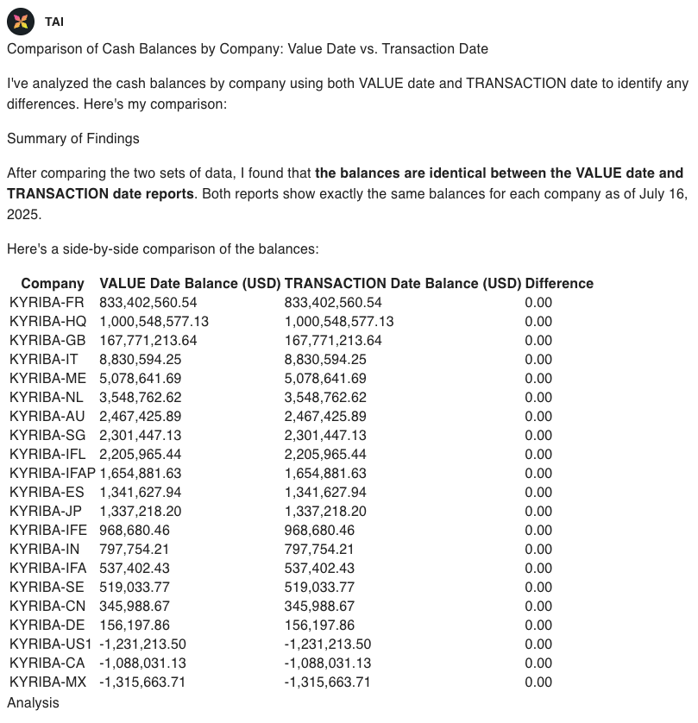
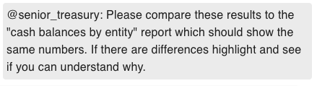
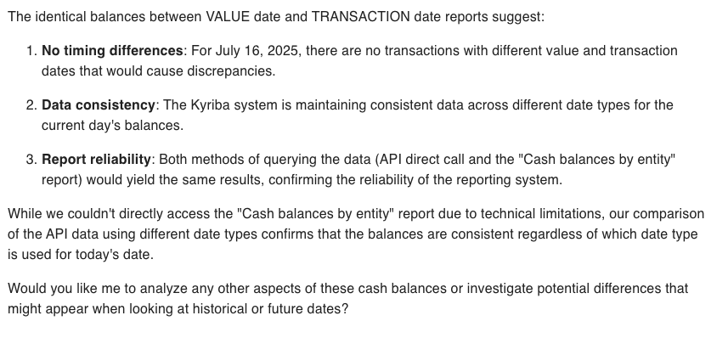
What errors should Support expect?
Values are not what I expect?
Answer: Ask TAI to compare against a report (see example) or to look through the reasoning steps containing the data retrieved from the API or report to understand. Try and replicate and problem solve using your expertise with Kyriba.
AI can hallucinate: use “A Practical Guide for Treasury and Finance: How AI Agents Work” - expected to be published on the 15th November
Notes:
Mention that access to all reports is now available and show how can be used to validate results

Slide 12
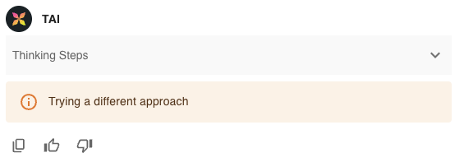
What errors should Support expect?
Why can’t TAI do [insert]?
A.I. has its limitation and TAI cannot yet do everything planned in its roadmap.
Use and/or share with the customer the Factsheet: TAI Capabilities to help manage expectations.
Escalate any useful feedback.
I can’t see what my colleague can see?
Access to data is based on the user’s data permissions
How do I turn on TAI?
Go to TAI - Agentic AI - Handbook for instructions.
Commercial questions redirect to Account Manager
The following error can have a number of causes. Error reporting will be improved over time.
Escalate any such issues for Anton to pick up.

Slide 13
What errors should Support expect?
Bad Prompt Example: "Are there errors in my forecasts?"
Problems:
Ambiguous: What is an "error"?
No Scope: Which forecasts? Which time period? Which subsidiary?
Unclear Data Source: Where should the data come from?
Vague Terminology: "Forecasts" could mean different things (cashflows, budgets, etc.)
Good Prompt Example:
"For subsidiary ABC Corp, for the last week, identify all cashflows with status 'Confirmed Forecast' that do not have a matching cashflow with status 'Actual' in the same period. Use the 'Cashflow Forecast vs Actuals' report as the primary source. List these unmatched forecasts as potential errors."
Best Practices Applied:
Clear Scope: Specifies subsidiary and date range.
Precise Terminology: Defines "forecasts" as cashflows with status 'Confirmed Forecast'.
Defines "Error": Unmatched to cashflows with status 'Actual'.
Data Source Stated: Specifies which report to use.
Actionable Output: Requests a list of unmatched forecasts.
A well-designed prompt is specific, unambiguous, and context-rich—leading to accurate, actionable AI answers.
Note, writing long prompts will get tiresome for customers. Kyriba is working on “pre-prompting” and “agent building” for customers to resolve.
In the interim, advise customers to copy good prompts to a text file so they can be reused.

Slide 14
Managing customer expectations
There are risks that customers:
Assume AI can do anything and everything
Not sure where to start with TAI
This PDF factsheet covers TAI capabilities to support and help set expectations: Factsheet TAI Capabilities
The following links are also useful to share:
Kyriba Elevate TAI course: Optimizing TAI
A Practical Guide for Treasury and Finance: How AI Agents Work - expected to be published on the 15th November
To note:
Be aware TAI cannot yet perform actions in Kyriba. This is being worked on.
Over time more APIs and documentation will be added to expand TAI’s capabilities.
At the moment customers have to carefully prompt every question in detail.
It is on the roadmap to build “pre-prompting” and “agent building” which in future will reduce the work.

Slide 15
How to get help
How to get support and pass on customer feedback:
Ad-hoc support:
Discuss with SMEs and other Support members at #TAI-Support
Ad-hoc feedback:
Post on #TAI-Feedback
If there is an error in the Product:
Escalate to Product in Salesforce (creating a JIRA “Production Management: Escalation” ticket).
If the customer has a feature request for the Product:
Escalate to Product in Salesforce (creating a JIRA “Production Management: Escalation” ticket).
What information should you include:
So that Product can find the issue:
Platform
Date and time
Request ID (If/when available)
So that Product can analyse the issue:
Explanation of why the customer thinks there is a problem and what the expected output was.
Full replication of the problem in CMP11
Full conversation (including history)
Reasoning steps

Slide 16
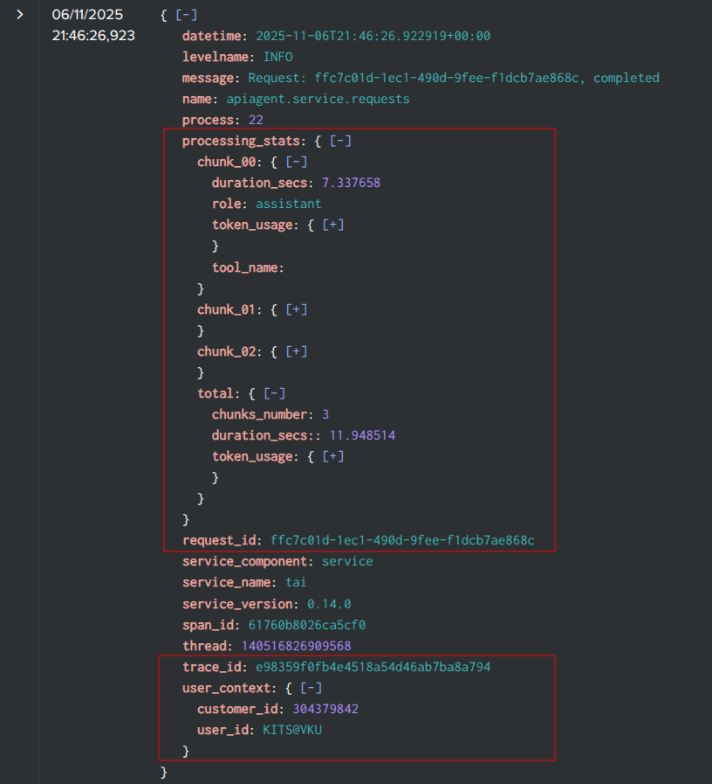
TAI logs in Splunk
Expectations:
It is not expected that Support will need to review Splunk.
Technical errors are not expected and, in the short term, any errors should be escalated.
In time, with more production experience, this can be revisited.
Available now:
Service and agent logs are joined using trace_id
User context is visible in logs (service - done, agent - coming)
Request processing statistics (streamed chunks, token usage, duration)
In progress:
Propagating traces to MCP tools
Whitelisting traceparent in Gravitee
Expected in future:
Request ID included in TAI output within the User Interface (UI)
More information in [TAI] Logging

Slide 17
Thank you.
Break - 5 mins
Q & A
Subtitle goes here

Slide 18
How to setup
Adam Bridgewater
A.I. Innovation Manager

Slide 19
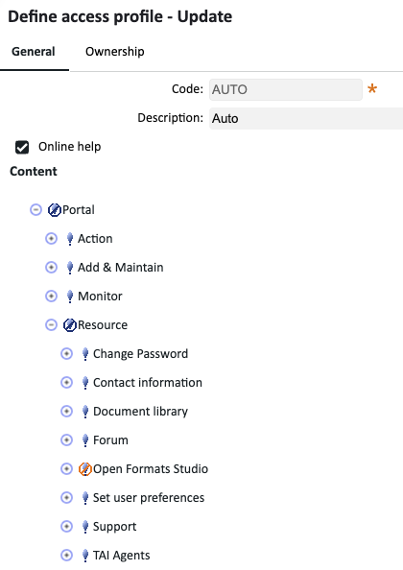
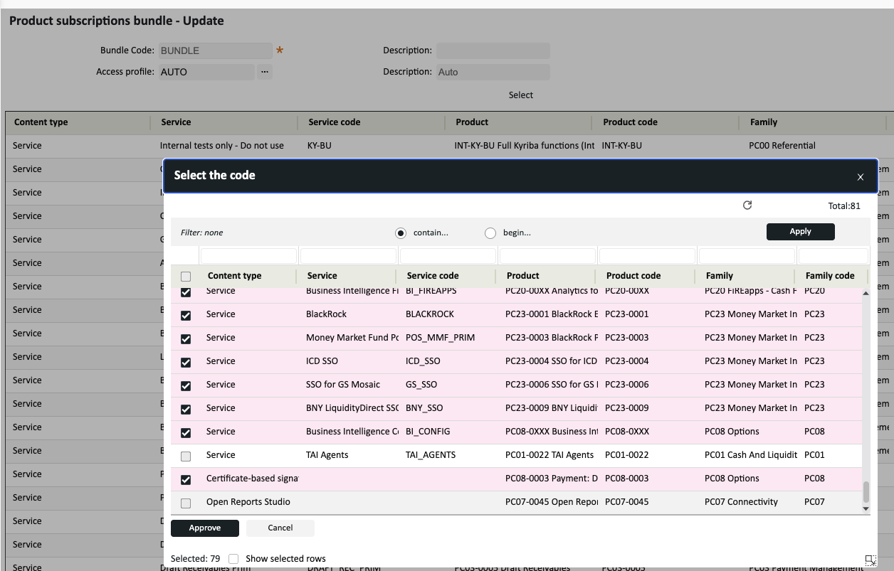
Activation: How to activate TAI
TAI will be enabled either be via the Access profile or Product subscription bundles.
See TAI - Agentic AI - Handbook for more information

Slide 20
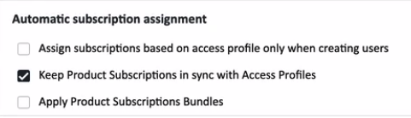
Key points covered in TAI - Agentic AI - Handbook
Whether Product subscription or Access Profile is needed to enable TAI is dependant on the
Automatic subscription assignment setting in processing options
The number of users allowed is currently tied to the number of Cash Management Primary users.

Slide 21
Activation: Describing reports fully
TAI uses the “search_report_library” to find the right report to run.
If all the reports have a descriptions such as “Cash_1” or “Cash_2”, then TAI won’t know which report is best for the question.
To help TAI , it would be best if reports are well described so that they are selected by TAI more efficiently:
E.g. “Cash position worksheet by subsidiary in USD, actuals & forecasts by budget code”
In general up to 100 characters available.
This will allow TAI to more easily find and choose the right report for the question asked.
Note: TAI already knows the type of report.
In addition, adding “ TAI” or “TAI ” or in the description will prioritise the report over similar reports.

Slide 22
How does TAI work
Adam Bridgewater
A.I. Innovation Manager

Slide 23
Activation: How does TAI get data?
TAI has access to a number of the Kyriba APIs
TAI connects to Kyriba APIs via the API team’s Model Context Protocole (MCP server)
Model Context Protocol (MCP), an emerging open protocol that lets AI applications (clients) securely connect to external tools, data sources, and actions.
TAI treasury agent
When a user asks a question of the TAI treasury agent, it uses the access and permissions of that user on the API calls.
A user can only see the reports and data they normally have permission for in Kyriba.
TAI connects to mcp/API out of the box - no PS effort required
MCP Server
Kyriba APIs
Customer Database

Slide 24
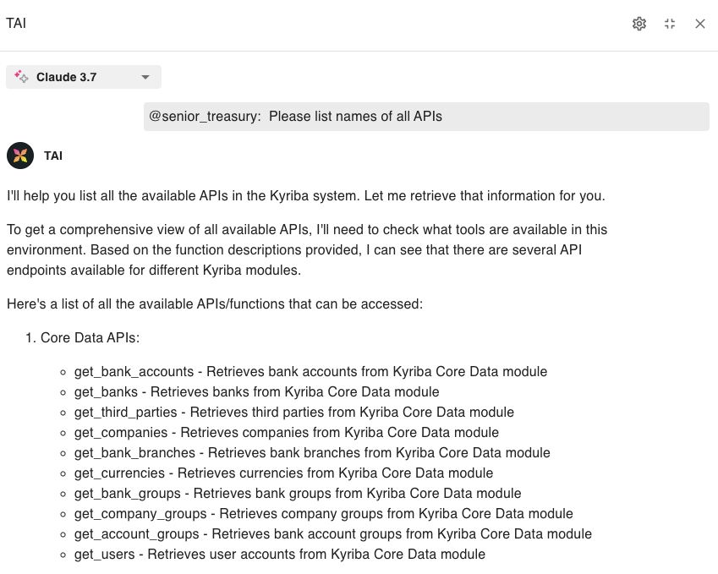
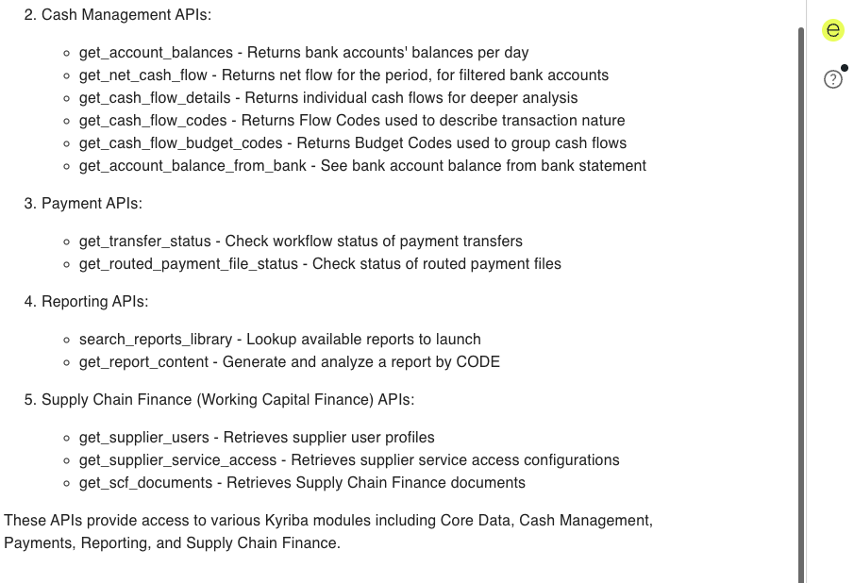
Scope of data used by TAI: APIs
Notes:
Stress that sometimes you just need information quickly

Slide 25
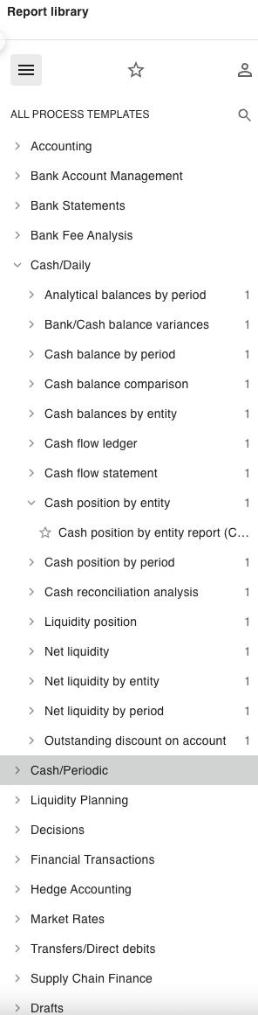
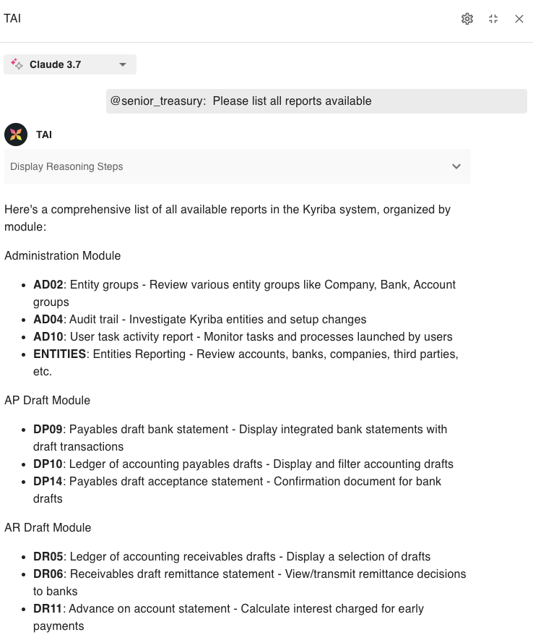
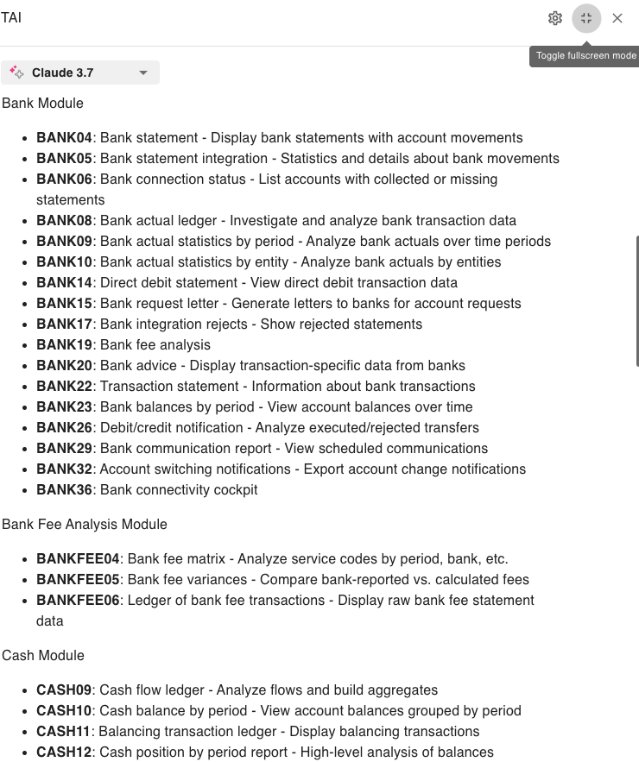
Scope of data used by TAI:Reports
Notes:
Mention reports have to be set up to work

Slide 26
Where to go for:
Training: Kyriba Elevate TAI course: Optimizing TAI
Deeper information:
A Practical Guide for Treasury and Finance: How AI Agents Work - expected to be published on the 15th November
TAI Release note
TAI Online help
Kyriba developer portal for APIs
Ask TAI/Dust/Google about AI, MCP

Slide 27
Follow-up points
Hope to run a follow up Q&A session after TAI is live to collect experiences and answer questions
João Pedro Almeida
Manager, Northern Europe and Germany - Client Support EMEA

Slide 28
Support: TAI 1-Pager
Interface demo (what can I see there)
Navigation, conversations & limitations, context & clearing, charting, reasoning
Help agent, How units work, clearing cache trick
Scope of data used by TAI
Treasury agent: MCP & reports
How to setup reports for TAI - descriptions and TAI
Help agent: Online help
Activation:
How does TAI get data?
How to enable TAI: TAI - Agentic AI - Handbook
Describing reports fully
Managing customer expectations
Provide customers with: Factsheet TAI Capabilities
Limitations: Read not yet write. API list will expand. More documentation and agent building will be added.
Units not the same as questions
TAI limited to the user permissions
Where to go for:
Training: Kyriba Elevate TAI course: Optimizing TAI
Deeper information:
A Practical Guide for Treasury and Finance: How AI Agents Work
Release note & Online help
Kyriba developer portal for APIs
Feedback: #TAI-Feedback
Support queries: JIRA escalation process
Inter-support general discussion: #TAI-Support

Slide 29
Thank you.
Thank you.
Q & A
Subtitle goes here

Slide 30
Additional information

Slide 31
What can a customer do with TAI

Slide 32
Examples of uses of TAI over reports
Check if bank statements received by looking at the Bank Cockpit report
Highlight variances against proof of cash report
Show me payments pending approval via payment dashboard report
Check for variances in forecasts from the forecast variances report.
Check if any bank transactions are on hold and check if any matching forecasts.
Check if any liquidity shortfalls

Slide 33
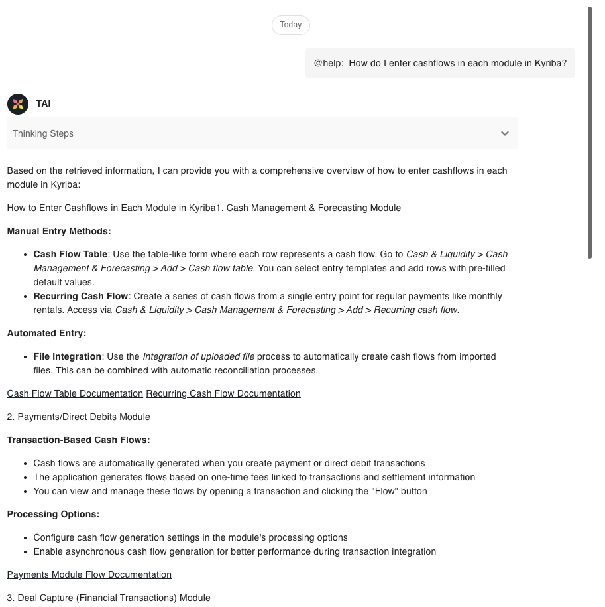
Scope of data used by TAI: Help agent
Help agent accesses Online Help data.
It performs a full “Semantic search” by meaning across all modules.
Release notes are not yet available but planned.
More documentation planned for the medium term.

Slide 34
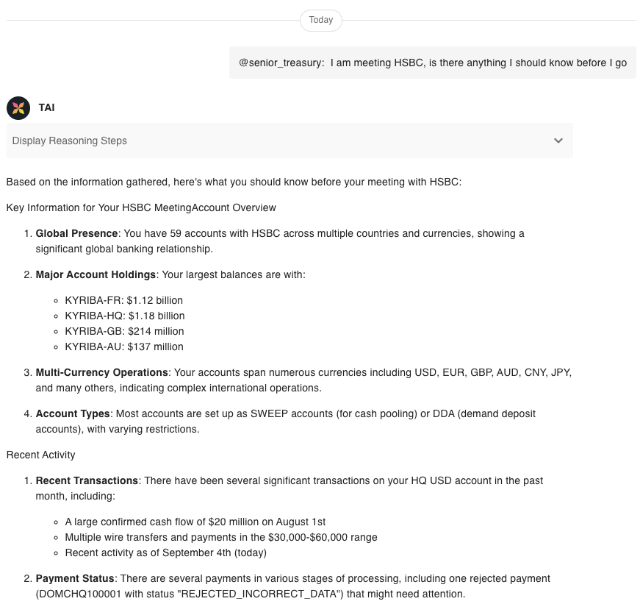
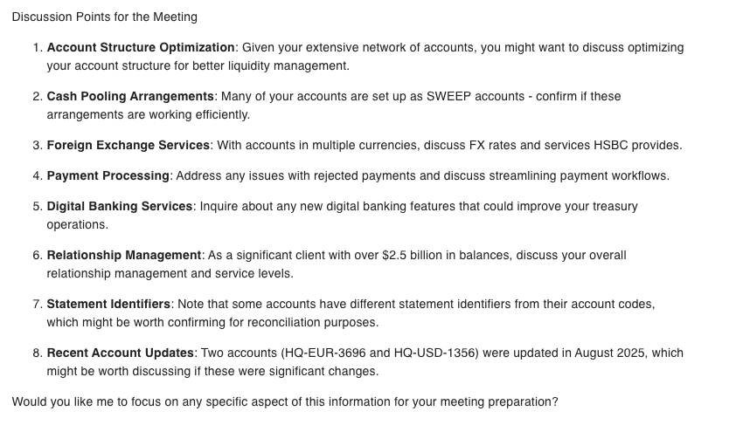
Example open question: Bank meeting

Slide 35
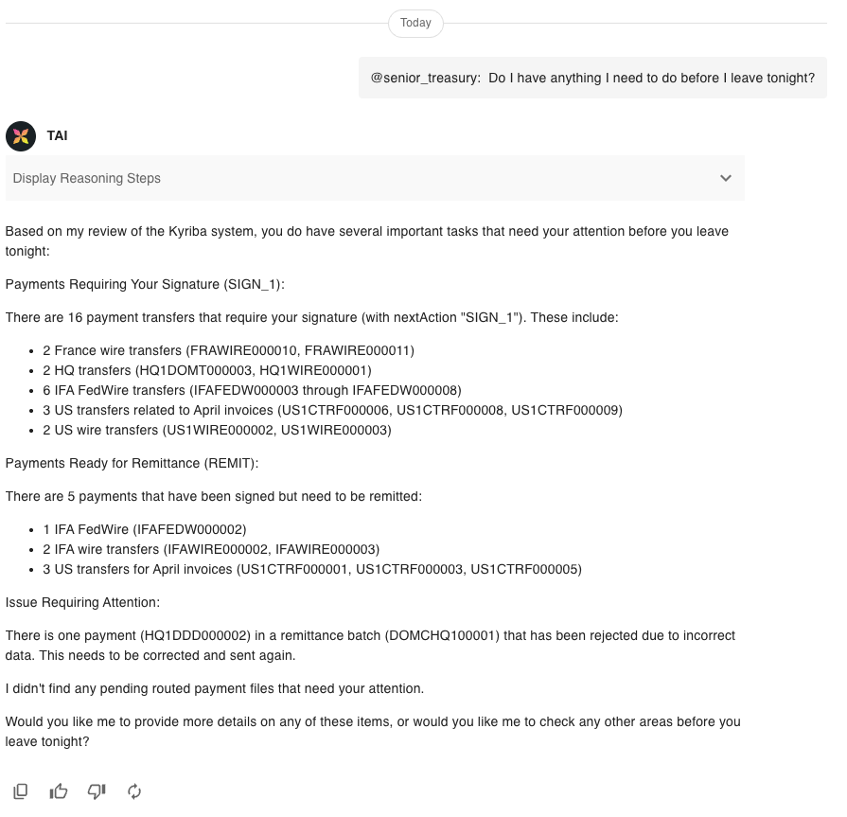
Example open question: End of the day

Slide 36
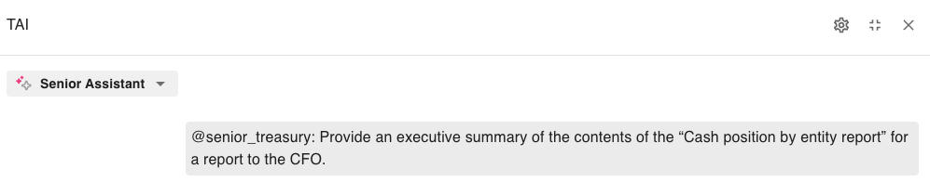
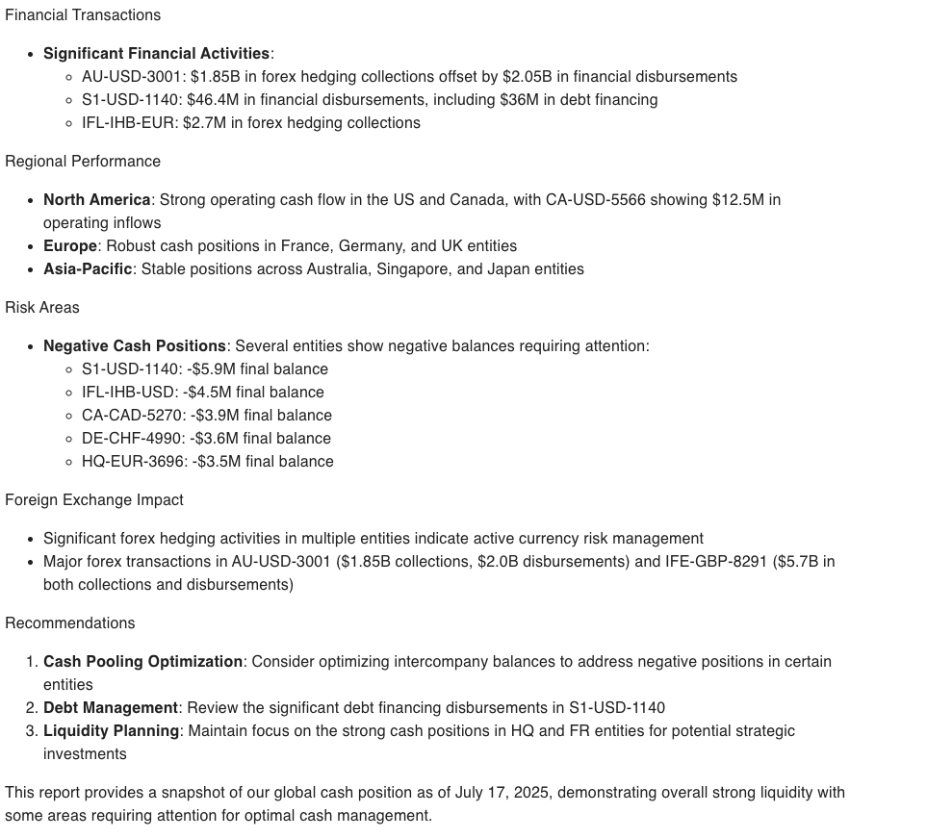
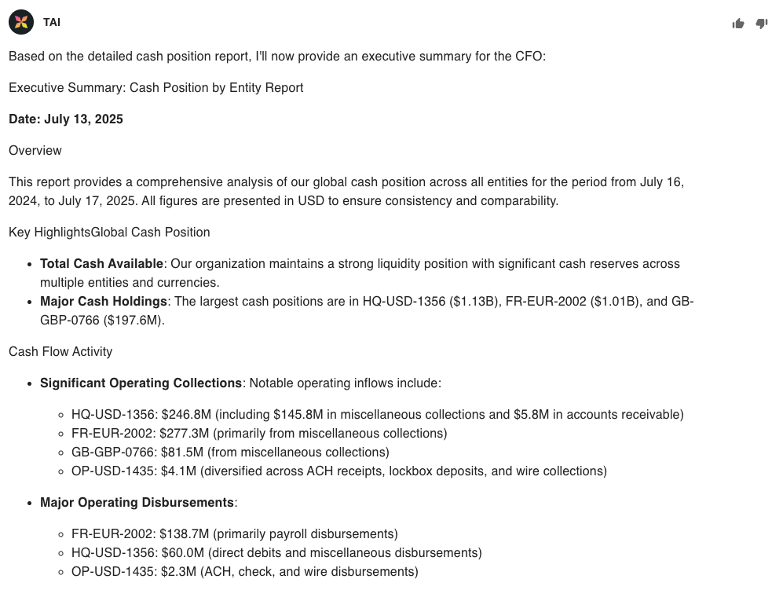
Example question: Executive reporting

